Slide 1


Slide 2
IMP Note to Students
It is important to know that just login to the session does not guarantee the attendance.
Once you join the session, continue till the end to consider you as present in the class.
IMPORTANTLY, you need to make the class more interactive by responding to Professors queries in the session.
Whenever Professor calls your number / name ,you need to respond, otherwise it will be considered as ABSENT

Slide 3
Course Name :
Middleware Technologies CSIW ZG524

Slide 4
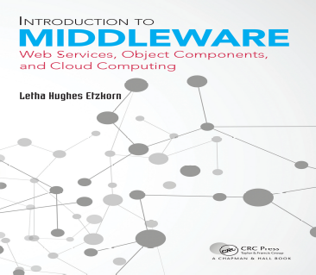
Textbooks
T1: Letha Hughes Etzkorn - Introduction to middleware _ web services, object components, and cloud computing-Chapman and Hall_CRC (2017).
T2: William Grosso - Java RMI (Designing & Building Distributed Applications)
R1: Gregor Hohpe, Bobby Woolf - Enterprise Integration Patterns_ Designing, Building, and Deploying Messaging Solutions -Addison-Wesley Professional (2003)
R2: MongoDB in Action
Note: In order to broaden understanding of concepts as applied to Indian IT industry, students are advised to refer books of their choice and case-studies in their own organizations

Slide 5
Modular Structure
No | Title of the Module
M1 | Introduction and Evolution
M2 | Enterprise Middleware
M3 | Middleware Design and Patterns
M4 | Middleware for Web-based Application and Cloud-based Applications
M5 | Specialized Middleware

Slide 6
CS4: Integration Styles and Messaging Systems

Slide 7
CS3: Enterprise Application Integration
Challenges, Patterns, Solutions

Slide 8
Agenda
Integration Challenges
Enterprise Information Systems
Enterprise Application Integration

Slide 9
What is Information Systems
Enterprise information systems:
  Integrated ISs that support core BPs and functions.
  e.g. Marketing, Accounting, Finance, Info security, HR, Compliance, Production, Purchasing, and Logistics.
Examples of Information Systems:
Supply Chain Management − For managing suppliers, inventory and shipping, etc.
Human Resource Management − For managing personnel, training and recruiting talents;
Employee Health Care − For managing medical records and insurance details of employees;
Customer Relationship Management − For managing current and potential customers;
Business Intelligence Applications − For finding the patterns from existing data from business operations.
ERP: Enterprise resource planning
CPFR: Collaborative planning, forecasting, and replenishment
KM: Knowledge management

Slide 10
Need for Integration of Applications
All these systems work as individual islands of automation. Most often these systems are standalone and do not communicate with each other due to incompatibility issues such as
  Operating systems they are residing on;
  Database system used in the system;
  Legacy systems not supported anymore.
Main EIS need is for data integration (data sharing/ exchange):
  e.g, ERP & SCM improve SC; KM & CRM for (un)profitable customers
  All these are facilitated by communication!

Slide 11
EAI
EAI is an integration framework, a middleware, made of a collection of technologies and services
EAI allows smooth integration of all such systems and applications throughout the enterprise and enables data sharing and more automation of business processes.
Characteristics of EAI:
  EAI is defined as "the unrestricted sharing of data and business processes among any connected applications and data sources in the enterprise."
  Allows integration without any major changes to current infrastructure.
  Extends middleware capabilities to cope with application integration.
  Uses application logic layers of different middleware systems as building blocks.
  Keeps track of information related to the operations of the enterprise e.g. Inventory, sales ledger and execute the core processes that create and manipulate this information.

Slide 12
EAI
Need for EAI
  Unrestricted sharing of data and business processes across an organization.
  Linkage between customers, suppliers and regulators.
  The linking of data, business processes and applications to automate business processes.
  Ensure consistent qualities of service (security, reliability etc.).
  Reduce the on-going cost of maintenance and reduce the cost of rolling out new systems.
Challenges of EAI
  Hub and spoke architecture concentrates all of the processing into a single server/cluster.
  Often became hard to maintain and evolve efficiently.
  Hard to extend to integrate 3rd parties on other technology platforms.
  The canonical data model introduces an intermediary step.
  Added complexity and additional processing effort.
  EAI products typified.
  Heavy customization required to implement the solution.
  Lock-In − Often built using proprietary technology and required specialist skills.
  Lack of flexibility − Hard to extend or to integrate with other EAI products!
  Requires organization to be EAI ready.

Slide 13
Integration Challenges
Enterprise integration is no easy task
Enterprise integration has to deal with multiple applications running on multiple platforms in different locations
EAI suites for Integration
Cross-platform, cross-language integration as well as the ability to interface
Enterprise integration requires a significant shift in corporate politics
A failing or misbehaving integration solution can cost a business millions of Dollars in lost orders, misrouted payments and disgruntled customers.
One important constraint of developing integration solutions is the limited amount of control the integration developers typically have over the participating applications.
Despite the wide-spread need for integration solutions, only few standards have established themselves in this domain
The advent of XML, XSL and Web services certainly mark the most significant advance of standards-based features in an integration solution.
While developing an EAI solution is challenging in itself, operating and maintaining such solution can be even more daunting.

Slide 14
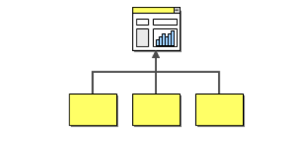
Integration Projects
Information Portals
Data Replication
Shared Business Functions
Service-Oriented Architectures
Distributed Business Processes
Business-to-Business Integration
Information Portals:
Many business users have to access more than one system to answer a specific question.
A customer service representative may have to access the order management system on the mainframe plus log on to the system that manages orders placed over the Web.

Slide 15
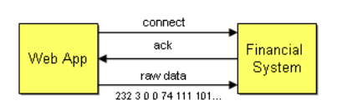
Integration Solutions
Tightly Coupled Integration Solution
Loosely Coupled Integration Solution
Tightly Coupled Integration:
Effects of tightly coupled dependencies.
How to resolve them?
Front-end Web application has to be integrated with the back-end financial
Easiest way is to use TCP/IP connectivity
Platform Technology – internal representations of numbers and objects
Location – hard-coded machine addresses
Time – all components have to be available at the same time
Data Format – the list of parameters and their types must match

Slide 16
Patterns
Proxy
  Design pattern: representative for remote access
Factory
  Design pattern: object creation
Wrapper
  Design pattern: interface transformation
Interceptor
  Architectural pattern: adaptable service provision
These patterns appear very frequently in middleware construction

Slide 17
Integration Patterns
Channel Patterns describe how messages are transported across a Message Channel. These patterns are implemented by most commercial and open source messaging systems.
Message Construction Patterns describe the intent, form and content of the messages that travel across the messaging system. The base pattern for this section is the Message pattern.
Routing Patterns discuss how messages are routed from a sender to the correct receiver. Message routing patterns consume a message from one channel and republish it message, usually without modification, to another channel based on a set of conditions. The patterns presented in this section are specializations of the Message Router pattern.

Slide 18
Integration Patterns
Transformation Patterns change the content of a message, for example to accommodate different data formats used by the sending and the receiving system. Data may have to be added, taken away or existing data may have to be rearranged. The base pattern for this section is the Message Translator.
Endpoint Patterns describe how messaging system clients produce or consume messages.
System Management Patterns describe the tools to keep a complex message-based system running, including dealing with error conditions, performance bottlenecks and changes in the participating systems.

Slide 19
CS4: Integration Styles and Messaging Systems

Slide 20
Agenda
Introduction
Application Integration Criteria
Application Integration Options

Slide 21
Application Integration Criteria
If you can develop a single, stand-alone application that doesn’t need to collaborate with any other applications
We can avoid the whole integration issue entirely.
  Application coupling
  Integration simplicity
  Integration technology
  Data format
  Data timeliness
  Data or functionality
  Asynchronicity

Slide 22
Application Integration Criteria
Application Coupling:
  Integrated applications should minimize their dependencies on each other so that each can evolve without causing problems for the others.
  Tightly coupled applications make numerous assumptions about how the other applications work
  The interface for integrating applications should be specific enough to implement useful functionality
Integration Simplicity:
  Integrating an application into an enterprise, developers should strive to minimize changing the application and minimize the amount of integration code needed.
  To provide good integration functionality and the approaches with the least impact on the application may not provide the best integration into the enterprise.

Slide 23
Application Integration Criteria
Integration Technology:
  Different integration techniques require varying amounts of specialized software and hardware.
  These special tools can be expensive, can lead to vendor lock-in, and increase the burden on developers to understand how to use the tools to integrate applications.
Data Format:
  Integrated applications must agree on the format of the data they exchange, or must have an intermediate translator to unify applications that insist on different data formats.
  A related issue is data format evolution and extensibility—how the format can change over time and how that will affect the applications.
Data Timeliness:
  Integration should minimize the length of time between when one application decides to share some data and other applications have that data.
  Data should be exchanged frequently in small chunks, rather than waiting to exchange a large set of unrelated items.
  Applications should be informed as soon as shared data is ready for consumption.

Slide 24
Application Integration Criteria
Data Functionality:
  Integrated applications may not want to simply share data, they may wish to share functionality such that each application can invoke the functionality in the others.
  Invoking functionality remotely can be difficult to achieve, and even though it may seem the same as invoking local functionality, it works quite differently, with significant consequences for how well the integration works.
Asynchronocity:
  Where the remote application may not be running or the network may be unavailable—the source application may wish to simply make shared data available or log a request for a sub procedure call– Asynchronicity.

Slide 25
Application Integration Options
File Transfer — Have each application produce files of shared data for others to consume, and consume files that others have produced.
Shared Database — Have the applications store the data they wish to share in a common database.
Remote Procedure Invocation — Have each application expose some of its procedures so that they can be invoked remotely, and have applications invoke those to run behaviour and exchange data.
Messaging — Have each application connect to a common messaging system, and exchange data and invoke behavior using messages.

Slide 26
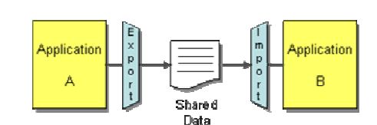
File Transfer
Have each application produce files containing information that other applications need to
consume.
Integrators take the responsibility of transforming files into different formats.
Produce the files at regular intervals according to the nature of the business.
An important decision with files is what format to use. Very rarely will the output of one application be exactly what's needed for another, so you'll have to do a fair bit of processing of files along the way.
File Transfer simple is that no extra tools
or integration packages are needed, but that
also means that developers have to do a lot
of the work themselves.

Slide 27
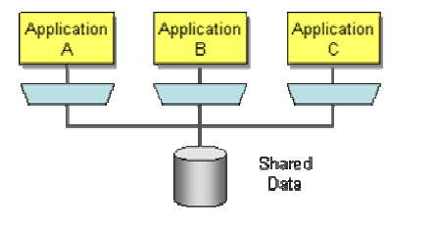
Shared Database
File Transfer enables applications to share data, but can lack timeliness, yet timeliness of
integration is often a critical issue. File Transfer also may not enforce data format sufficiently.
Shared Database is made much easier by the widespread use of SQL-based relational databases. Biggest difficulties with Shared Database is coming up with a suitable design
Multiple applications using a Shared Database to frequently read and modify the same data can cause performance bottlenecks and even deadlocks as each application locks others out of the data

Slide 28
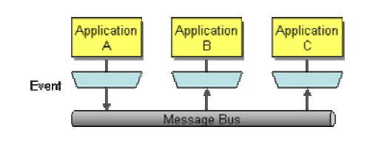
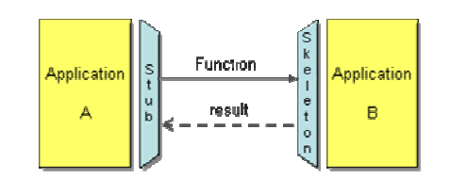
Remote Procedure Invocation
Remote Procedure Invocation applies the principle of encapsulation to integrating applications.
There are a number of Remote Procedure Call (RPC) approaches: CORBA, COM, .NET Remoting, Java RMI, etc.
Messaging: Asynchronous messaging is fundamentally a pragmatic reaction to the problems of distributed systems.
The high frequency of messages in Messaging reduces many of the inconsistency problems

Slide 29




Messaging Systems
Message Structure is well defined by the messaging system used. It usually contains header and body sections.
Channels are the mediums where messages are produced. They are the usual queue and topics
Pipe and Filters pattern is useful when one needs to process messages before they are delivered to consumer applications.
Message Router: When the sender application does not know on which channel the receiver is subscribed to. A router is used in between for delivering messages on the correct channel. It has routing rules that decides where the messages shall be delivered.

Slide 30


Messaging Systems
Translators are used to change the format of message. The sender application might send CSV data while the receiver application understands XML, in that case we need to have a translator before the receiving application that does the job of CSV to XML conversion.
Endpoint is a component that helps an application interact with messaging systems. They have the protocol built in for communication with the messaging systems. They are the message producers and the consumers.

Slide 31
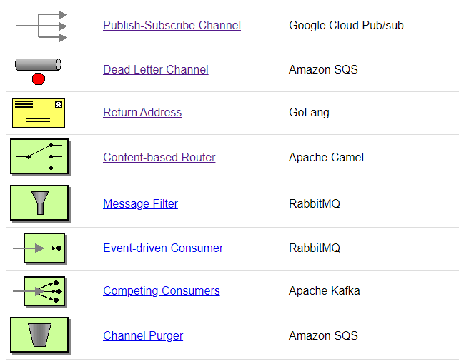
Some Pattern examples

Slide 32
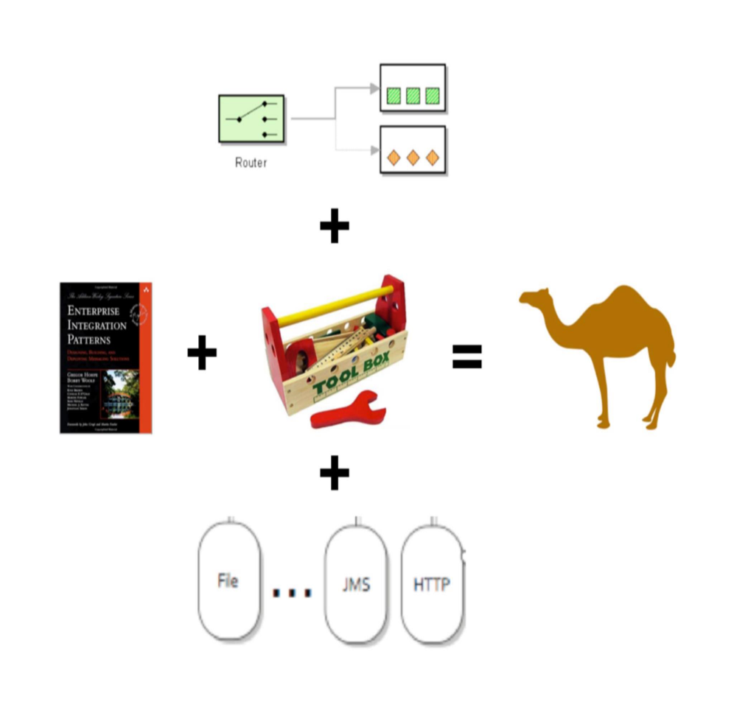
Integration Framework – Apache Camel
Powerful open source integration framework based on EIP
java framework for integration and mediation
rules in multiple DSLs:
  Fluent Java
  Spring XML
  Blueprint XML
  Scala
over > 150 out-of-box components
bean binding and integration with popular frameworks
active community ~ 900 messages/month

Slide 33
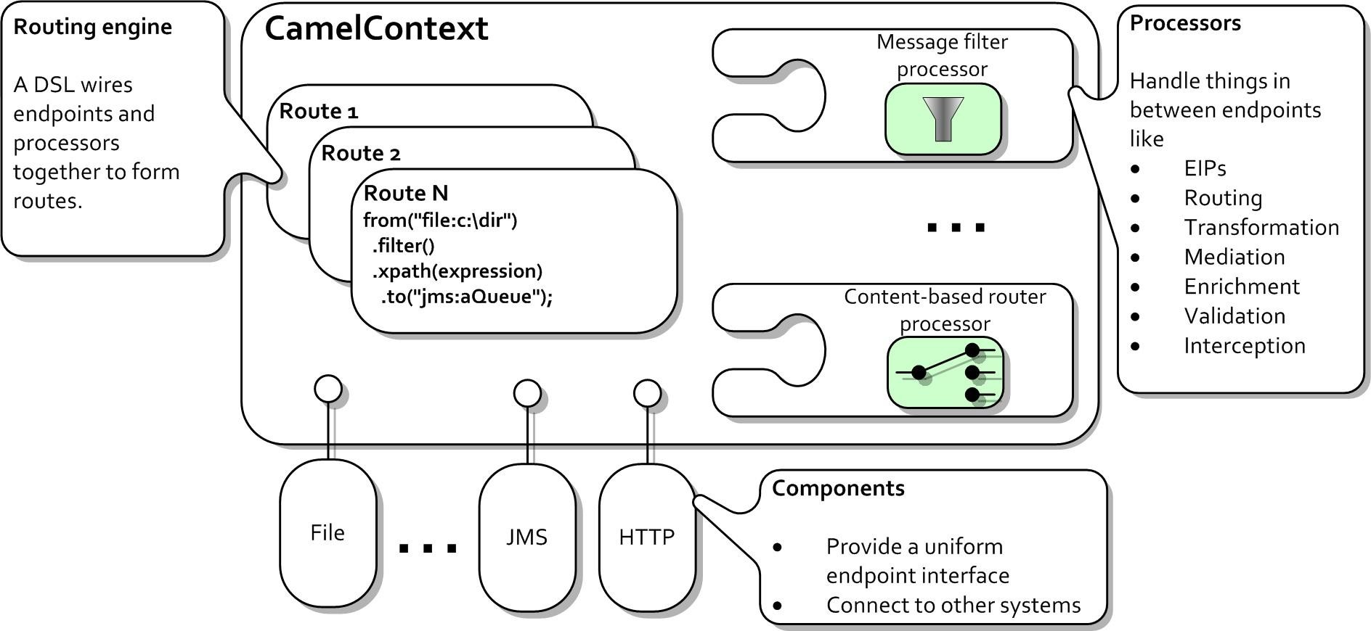
Camel Architecture
Image from: (Camel in Action)

Slide 34
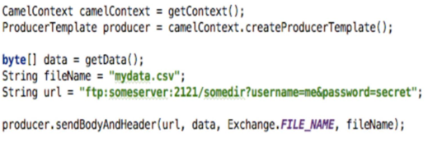
Camel Basics
CamelContext object represents the Camel runtime system.
Registry: Holds all the bean necessary for routings.
Exchange: contains message related headers properties.
TypeConverter: Type conversion utility for converting types.
Component is a factory for creating Endpoint instances.
  create a CamelContext
  optionally configure components or endpoints
  add routing rules
  start the context
Producer Template

Slide 35
Apache Camel

Slide 36
Apache CAMEL
Apache Camel is an integration library for Java.
It’s a set of Java APIs that help you integrate and process data between different computer systems.
Camel is like glue between different applications.
Camel comes with components that let you integrate lots of different applications – everything from web services, to reading and writing files on disk.
You can even connect Camel with web apps like Twitter and Salesforce.
You can think of Camel as a plumbing toolkit for Java.
Just like real plumbing pipes, Camel takes data from one point, and pipes it to another.
Along the way, the data can be changed, transformed, or sent through other pipes.
Included in your plumbing toolkit is a range of adaptors that fit all sorts of different apps and software systems.
With a full range of tools at your disposal, it’s then up to you how you choose to build the plumbing.
Camel was inspired by the book Enterprise Integration Patterns, which is an academic textbook about integrating software systems.

Slide 37
Apache CAMEL
Camel facts :
It’s built in Java
The entire code is completely open source
It’s not just for web services – it’s a general integration framework
It comes with a huge library of components
It’s mature – Apache Camel is at the foundation of some commercial integration products, like Red Hat Fuse and Talend ESB.
What is Camel used for?
Almost any time you need to move data from A to B, you can probably use Camel.
Any of the following scenarios could be implemented using Camel:
Picking up invoices from an FTP server and emailing them to your Accounts department
Taking files from a folder and pushing them into Google Drive
Taking messages from a JMS queue and using them to invoke a web service
Making a web service that allows users to retrieve customer details from a database

Slide 38
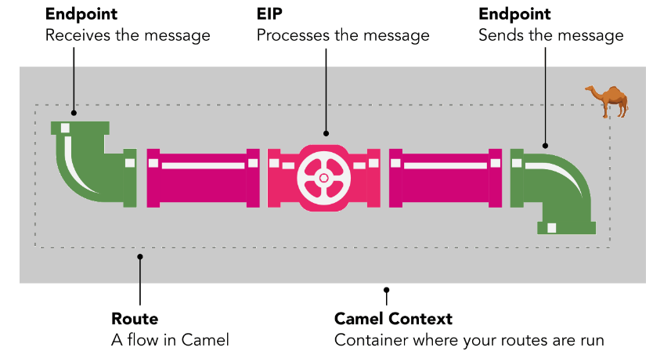
Apache CAMEL

Slide 39
Apache CAMEL
Route
The basic concept in Camel is the route.
Routes are objects which you configure in Camel, which move your data from A to B.
To use the plumbing example from earlier, a route is a pipe that moves data from one place to another.
It moves data between things called endpoints.
You can create routes in Camel either using a Java syntax, or using an XML syntax.
Here’s a very simple Java route:
// This is a complete Camel route definition!
from("file:home/customers/new")
.to("file:home/customers/old")

Slide 40
Apache CAMEL
Endpoints
In Camel, an endpoint represents any other external system to Camel.
For an example, at the start of a route, Camel receives a message from an endpoint.
Then, the message might be processed in some way – perhaps by an EIP – before being sent to another destination endpoint.
Components
To allow Camel to connect to an endpoint, it comes with a library of components.
A component is simply like a plug that allows you to connect to an external system (such as a file on disk, a mailbox, or an app like Dropbox, Twitter, etc).
You can also think of it like an adaptor.

Slide 41
Apache CAMEL
Camel components are reusable, open source, and you can even contribute your own.
Here are some of the most common components, and how you might reference them in an endpoint.
As you can see, each component can usually read and write:
A component that is configured to write something is called a producer – for example, writing to a file on disk, or writing to a message queue.
A component that is configured to read something is called a consumer – for example, reading a file from disk, or receiving a REST request.
Between each endpoint, the data can also be transformed or modified, either by passing the data through another endpoint, or by using an EIP.
Component | Purpose | Endpoint URI
HTTP | for creating or consuming web sites | http:
File | for reading and writing files | file:
JMS | for reading and writing to messaging queues | jms:
Direct | for joining your Camel routes together | direct:
Salesforce | for getting data in and out of Salesforce | salesforce:

Slide 42
Apache CAMEL - Enterprise Integration Patterns (EIPs)
EIPs are another important part of Camel. They do special processing on messages.
When you want to perform some common activities on a message, such as transformation, splitting and logging, you’ll use an EIP.
EIP name | What it does | Java syntax
Splitter | Splits a message into multiple parts | .split()
Aggregator | Combines several messages into one message | .aggregate()
Log | Writes a simple log message | .log()
Marshal | Converts an object into a text or binary format | .marshal()
From* | Receives a message from an endpoint | .from()
To* | Sends a message to an endpoint | .to()

Slide 43
Apache CAMEL - Camel Context
Finally, to run and manage your routes,
Camel has a container called the Camel Context.
Your routes run inside this engine.
You could think of it almost like a mini application server.
When Camel starts, it reads your route definitions (in Java or XML), creates the routes, adds them to a Camel Context, and starts the Camel Context.
When Camel terminates, it shuts down your routes, and closes the Camel Context.

Slide 44
Apache CAMEL - Route
What does a Route look like?
Camel create routes that move data between endpoints, using components.
Although Camel is a library for Java, it can be configured using one of two languages - either Java or XML.
In Camel-speak, these are known as DSLs (Domain Specific Languages).
Each route starts with a from, configured with a URI, that defines the endpoint where the data is coming from.
A route can consist of multiple steps – such as transforming the data, or logging it.
But a route usually ends with a to step, which describes where the data will be delivered to.
A really simple route in Camel’s Java DSL could look something like this:
// This is a complete Camel route definition!
from("file:home/customers/new")
.to("file:home/customers/old")

Slide 45
Apache CAMEL - Route
That same route above could be expressed in Camel’s XML DSL like this:
<route>
<from uri="file:home/customers/new"/>
<to uri="file:home/customers/old"/>
</route>
But… what if we wanted to add another step in our route?
Let’s say we want to log a message when we’ve received a file.
Then we simply need to add our new step in between the existing steps. Like this:
<route>
<from uri="file:home/customers/new"/>
<log message="Received a new customer!"/>
<to uri="file:home/customers/old"/>
</route>
In the code above, a message is moved from the new folder to the old folder. In the middle, we use the Enterprise Integration Pattern (EIP) called log, which writes a simple Log message to the console

Slide 46
Apache CAMEL - What does data look like in Camel?
Camel treats data as individual messages – like letters flowing through a post office.
Each message is an individual object.
A message can be huge, or it can be very small. Camel has an object to represent messages, and helpfully it’s called Message.
A Message has a body, where the message content lives.
It also has headers, which can be used to hold values associated with the message.
The Message object is then passed along a route.
A Message is part of a Camel object called an Exchange.
You’ll often see the term Exchange mentioned in Camel documentation.
An Exchange is simply a message or interaction currently taking place inside your Camel route.

Slide 47
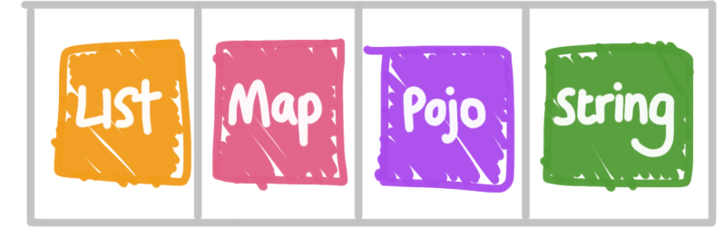
Apache CAMEL - What does data look like in Camel?
The important thing to understand about Camel’s message model is that the message body can contain almost any kind of Java object, such as a List, Map or String
The body doesn’t have to be a String, like JSON or XML.
The real power of Camel becomes clear when you start using these different types of objects.
Camel has good built-in support for converting between different object types.
In fact, for many common file types, you might barely even have to write any conversion code.

Slide 48
Apache CAMEL – Case Study - Assignment
Consider a situation where a large online grocery store in your town such as the
Bigbasket in India invites you to design an IT solution for them.
The stable and scalable solution will help them overcome the software maintenance problems they are facing today.
This online store has been running its business for the last decade.
The store accepts online orders for different categories of products from their customers and distributes those to the respective suppliers.
For example, suppose you order some soaps, oil and milk; these three items will be distributed to the three respective suppliers.
The three suppliers will then send their supplies to a common distribution point from where the entire order will be fulfilled by the delivery center.
Now, let us look at the problem they are facing today.

Slide 49
Apache CAMEL – Case Study - Assignment
When this store started its business, it was accepting orders in a comma-separated plain
text file.
Over a period of time, the store switched to message-driven order placement.
Later, some software developer suggested an XML based order placement.
Eventually, the store even adapted a web service interface.
Now, here comes the real problem. The orders now come in different formats.
At the same time, as the business kept on growing, the store periodically added new suppliers to its repertoire.
Each such supplier had its own protocol for accepting orders.
Once again, we face the integration issue; our application architecture must be scalable to accommodate new suppliers with their unique order placement mechanism

Slide 50
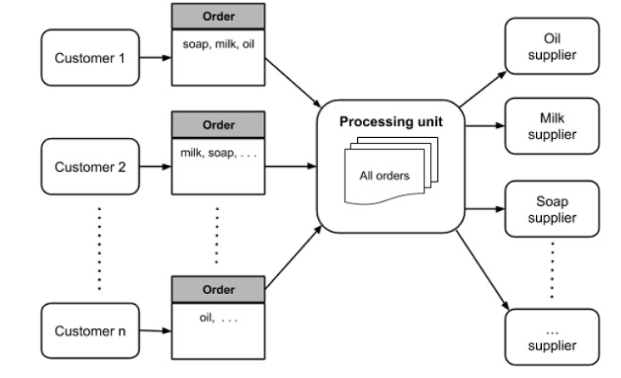
Assignment – Design an Integration Solution

Slide 51
Thank You

Slide 52


